Slide 1
Basic Facts and Computations
Building Fluency and Conceptual Understanding
Middle School Level
Copyright © 2016 American Institutes for Research. All rights reserved.
Notes:
This module focuses on the foundational skills of basic facts and building on these skills to application of multistep computations at the middle school grade level. This module reviews the math trajectories that lead to long-term success and mastery of facts. Mastery of facts will lead to deeper understanding of facts in order to complete multistep computations. This module is designed to be completed during a half-day professional development, but could be extended to a full day with case-study time in the afternoon.
Handouts are available, and not all slides are included in the handout material. Slides that are in the handout materials have a star on the slide.
Instructions for Using the Speaker’s Notes
• Text formatted in standard font is intended to be read aloud or paraphrased by the facilitator.
• Text formatted in boldface is excerpted directly from the presentation slides.
• Text formatted in italics is intended to serve as directions or notes for the facilitator; italicized text is not meant to be read aloud.
• Text formatted in underline indicates an appropriate time to click to bring up the next stage of animation in an animated slide.
Welcome participants to the training. Introduce yourself (or selves) as the facilitator(s) and briefly cite your professional experience in mathematics instruction and intensive academic intervention in mathematics.
Although permission to reprint this publication is not necessary, the citation should be: i3 Intensive Intervention in Mathematics. (2019). Basic facts and computations. Building fluency and conceptual understanding at the middle school level. Washington, DC: Education Innovation and Research Program, U.S. Department of Education.

Slide 2
Agenda: Morning
Using Data-Based Individualization (DBI) to Address Challenges With Math Facts and Computation
Basic Facts
Why is fact mastery important?
Facts within College and Career Readiness Standards
Vocabulary
Strategies for addition and subtraction
Strategies for multiplication and division
Notes:
[Read slide.]

Slide 3
Agenda
Computation
Connection between basic facts and multidigit and multistep computations
Connections and strategies for multidigit computations and place value
Common Core State Standards in computation
Error Analysis and Student-Level Planning
Case examples
Determining and practicing evidence-based approaches
Notes:
[Read slide.]

Slide 4
Participants will…
Understand common challenges that students with math difficulty face in reaching mastery of basic facts.
Understand challenges for students with mathematics difficulties in solving multidigit and multistep computations.
Review and discuss common strategies for solving basic facts, and applications for computations.
Design instructional adaptations for specific error patterns.
Notes:
[Read slide.]

Slide 5
Developing an Understanding of the DBI Process
Handout #1
Notes:
[The following four slides are all in the handout materials.]

Slide 6
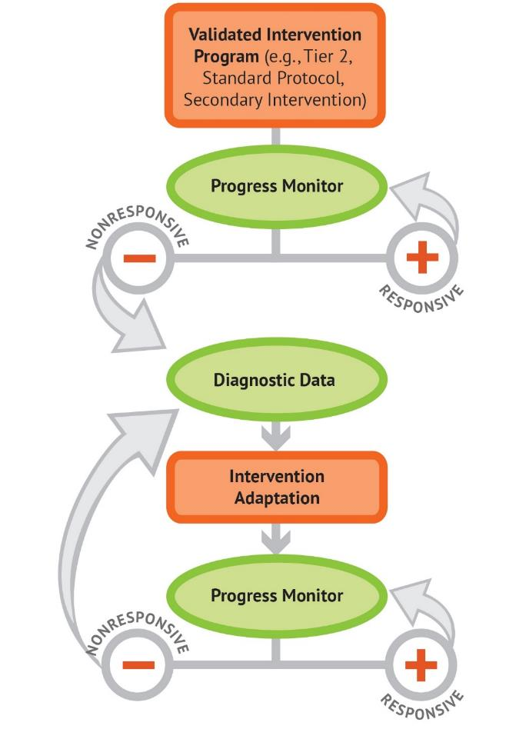
The DBI Process
Notes:
[Animated slide. Click at underlined text.]
The National Center on Intensive Intervention uses this graphic to illustrate the progression of data-based individualization, or DBI. We begin with a secondary intervention program, delivered with greater intensity, and progress monitor to determine the student’s response. If the student is responsive, we can continue the current intervention or consider reducing intensity as goals are met (depending on rate and duration of response and nature of skill deficits). If the student is not sufficiently responsive, we gather additional information through informal diagnostic assessment, which identifies student needs to guide intervention adaptations. We continue progress monitoring to make decisions about whether the student is responding to the adapted intervention.

Slide 7
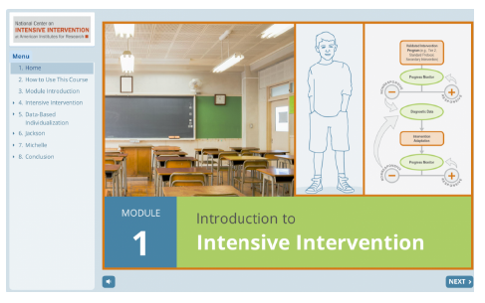
Introduction to Intensive Intervention
For additional information on the DBI process, check out the Introduction to Intensive Intervention module.
The self-paced module:
Defines intensive intervention and DBI;
Describes how intensive intervention fits within a tiered system such as MTSS (multi-tiered system of supports), RTI (response to intervention), or PBIS (positive behavior intervention and supports); and
Demonstrates how intensive intervention can provide a systematic process to deliver specialized instruction for students with disabilities.
https://intensiveintervention.org/resource/self-paced-introduction-intensive-intervention
Notes:
[Read slide.]

Slide 8
Characteristics of Instruction Across the Tiers
 | Primary (T1) | Secondary (T2) | Intensive (T3)
Instruction/ Intervention Approach | Comprehensive research-based curriculum | Standardized, targeted small-group instruction | Individualized, based on student data
Group Size | Classwide (with some small-group instruction) | 3–7 students | No more than 3 students
Monitor Progress | Once per term | At least once per month | Weekly*
Population Served | All students | At-risk students | Students with significant and persistent learning needs
DBI is an approach to intensive intervention.
* Or as indicated by the assessment instructions.
Notes:
[Review slide.]

Slide 9
Five DBI Steps
Secondary intervention program, delivered with greater intensity
Progress monitoring
Informal diagnostic assessment
Adaptation
Continued progress monitoring, with adaptations occurring whenever necessary to ensure adequate progress
Notes:
Throughout the DBI process, we use progress monitoring data to evaluate a student’s response to intervention, moving to the next component as needed.
Secondary intervention program, delivered with greater intensity. We usually begin by intensifying the secondary intervention already being used.
Progress monitoring data are used to evaluate the student’s response to the intensified intervention. If the student still is not showing enough progress, we collect and review additional data to determine specific skill deficits.
Informal diagnostic assessment data are used to identify skill deficits, which tell us how the intervention needs to be changed.
Adaptation. Based on data, we may choose to adapt the current intervention or try a new intervention.
Continued progress monitoring. This includes adaptations occurring whenever needed to ensure adequate progress.

Slide 10
Mathematics Facts
Handout #2
Notes:
[The next three slides are part of the handout; the standards are not. This is to allow for schools to insert different standards as needed.]

Slide 11
What skills are we talking about?
Whole-number computation and mathematics fact fluency, defined by National Council of Teachers of Mathematics (NCTM) (2002) as “having efficient and accurate methods for computing” (p. 152)
Connecting basic fact knowledge to multistep and multidigit computations
Notes:
[Read slide.]

Slide 12
Why do students struggle with math facts?
Ineffective strategy use
Weaknesses in the following:
Retrieval or fluency
Procedures
Higher level or conceptual understanding
Arithmetic relations among numbers
Working memory can affect a child’s ability to apply strategies to effectively solve whole-number computations and word problems
Sources: Geary, 1993, 2005; Gray, Pinto, Pitta, & Tall, 1999; Impecoven-Lind & Foegen, 2010; Jayanthi, Gersten, & Baker, 2008; Hecht, Close, & Santisi, 2003; Raghubar, Barnes, & Hecht, 2009; Swanson & Jerman, 2006; Swanson, Jerman, & Zheng, 2008
Notes:
Students struggle with math facts because they often use inefficient strategies to solve, thus never fully mastering or memorizing the facts. For many students, the inefficient strategies include counting all. For example, 5 + 3 would include counting five fingers and then counting on three more. A more efficient strategy would be to simply say 5 and then count on three more, so 5, 6, 7, 8 versus 1, 2, 3, 4, 5, 6, 7, 8. Additionally, students who struggle lack the understanding of how numbers are related—knowing that 5 + 3 is 8 and 8 – 3 = 5—thus, the idea of part-part-whole and how addition is related to subtraction.

Slide 13
What is expected of students?
Third-grade students demonstrate mastery, defined as at least 80% accuracy
Addition and subtraction facts
Products of two 1-digit numbers
Beyond basic fact mastery, students must extend fact knowledge to application of multistep problems involving different operations (CCSS-M & NCTM, 2014; NMAP, 2008)
Sources: National Governors Association Center for Best Practices & Council of Chief State School Officers: Common Core State Standards for Mathematics (CCSS-M) & NCTM, 2014; National Mathematics Advisory Panel (NMAP), 2008
Notes:
Ideally, students need to have mastery of basic facts (addition, subtraction, multiplication, and division) in order to be successful in multistep computations, fractions, and decimals. Teachers need to explicitly teach strategies that lead to mastery across the four skills. Ideally, by Grade 5, students will score 80% or better when given 1-minute assessments in addition, subtraction, multiplication, and division.

Slide 14
Role of Facts in Middle School
Should we still teach fact instruction beyond Grade 5?
Yes and no
Need to determine whether students have an understanding of fact and the idea of computational skills
Is it a weakness in procedural fluency or a lack of conceptual understanding?
How long has the student received explicit fact instruction?
Notes:
Fact instruction is important, but sometimes can be too encompassing or too much of a focus in the older grades. It is important that students understand the conceptual aspect of computation, such as addition is multiple parts to find a whole number and that we can use the whole to find a missing part, such as subtraction or even counting up. But if we focus only on addition and subtraction, students may be lacking exposure to and time for multiplication and division. We are going to talk about the connectedness of skills and how we may need to think about the time devoted to developing conceptual understanding and then utilizing tools, such as a calculator or multiplication chart, to complete the higher level skills.

Slide 15
Role of Facts in Middle School
Review fact strategies beginning with addition/subtraction, then multiplication/division
Addition and subtraction
If student can explain an efficient strategy, practice mixed problems.
Set a realistic goal.
Determine whether student understands regrouping.
If older than Grade 6, may want to consider calculator for addition and subtraction.
Multiplication and Division
Review effective strategies systematically.
Set a realistic goal.
Practice daily.
Provide practice and support in using multiplication chart beyond basic facts.
Notes:
[Read slide.]

Slide 16
College and Career Readiness Standards
Grades 4 and 5: Operations and Algebraic Thinking
Use the four operations with whole numbers to solve problems.
Gain familiarity with factors and multiples.
Generate and analyze patterns.
Write and interpret numerical expressions.
Analyze patterns and relationships.
Notes:
[Read slide.] While typical college and career readiness standards may not specifically state fact instruction or mastery, they do imply the knowledge and application of facts. The standards listed are examples, though each state may be slightly different.
[Standards from the Mathematics Common Core State Standards, Grade 4: http://www.corestandards.org/Math/Content/4/introduction/; Grade 5: http://www.corestandards.org/Math/Content/5/introduction/]

Slide 17
College and Career Readiness Standards
Grade 6:
Use ratio and rate reasoning to solve real-world and mathematical problems.
Apply and extend previous understandings of multiplication and division to divide fractions by fractions.
Compute fluently with multidigit numbers and find common factors and multiples.
Apply and extend previous understandings of arithmetic to algebraic expressions.
Reason about and solve one-variable equations and inequalities.
Notes:
While the standards do not explicitly identify basic computations, they are connected to grade-level standards and are important for students to have mastery in order to be successful on these standards.
[Standards from the Mathematics Common Core State Standards, Grade 6: http://www.corestandards.org/Math/Content/6/introduction/]

Slide 18
College and Career Readiness Standards
Grade 7:
Analyze proportional relationships and use them to solve real-world and mathematical problems.
Apply and extend previous understandings of operations with fractions.
Solve real-world and mathematical problems involving the four operations with rational numbers.
Use properties of operations to generate equivalent expressions.
Solve real-life and mathematical problems using numerical and algebraic expressions and equations.
Solve real-life and mathematical problems involving angle measure, area, surface area, and volume.
Notes:
[Standards from the Mathematics Common Core State Standards, Grade 7: http://www.corestandards.org/Math/Content/7/introduction/]

Slide 19
Common Core State Standards
Grade 8:
Know that there are numbers that are not rational, and approximate them by rational numbers.
Work with expressions and equations with radicals and integer exponents.
Understand the connections between proportional relationships, lines, and linear equations.
Analyze and solve linear equations and pairs of simultaneous linear equations.
Understand and apply the Pythagorean theorem.
Solve real-world and mathematical problems involving volume of cylinders, cones, and spheres.
Notes:
[Standards from the Mathematics Common Core State Standards, Grade 8: http://www.corestandards.org/Math/Content/8/introduction/]

Slide 20
Vocabulary for Teaching Facts and Computation
Handout #3

Slide 21
Vocabulary List
Brainstorm a list of words you use when teaching facts and computation.
READY
SET
GO!
Notes:
[Give 1 minute for each table to brainstorm a list of words that would be part of facts and computations. After 1 minute, have participants state the words round-robin style. The purpose is to show how much vocabulary is part of fact instruction that may or may not be explicitly taught. The following two slides…]

Slide 22
Vocabulary and Symbols: Addition and Subtraction
WORD | DEFINITION
Add | To combine amounts
Addend | An amount combined to another amount in an addition problem
Sum | The total in an addition problem
Subtract | To find the difference between two amounts; to take away
Difference | The end result in a subtraction problem
Additive | Problem types relating to addition and subtraction
Equal | The same as
Plus sign | +
Minus sign | -
Notes:
[This will not be part of participants’ handout copy. It will be provided after the meeting.]

Slide 23
Vocabulary and Symbols: Multiplication and Division
WORD | DEFINITION
Multiply | To increase an amount a number of times
Factor | An amount multiplied by another amount
Product | The end result in a multiplication problem
Divide | To break an amount into equal groups
Dividend | The starting amount in a division problem
Division | The number of groups in a division group
Quotient | The end result in a division problem
Multiplication sign | $$×$$
Division sign | $$÷$$
Notes:
[This will not be part of participants’ handout copy. It will be provided after the meeting.]

Slide 24
Example of a Frayer Model for a Facts Vocabulary Term
Multiplication
Student-friendly definition:
To increase an amount through repeated addition, arrays or equal-size groups
Picture or symbol:
4 $×$ 3
Picture or symbol:
4 × 3
Example:
4 $×$ 3 or 3 $×$ 4
4 groups of 3 or 3 groups of 4
4 + 4 + 4 = 3 + 3 + 3 + 3
Example:
4 × 3 or 3 × 4
4 groups of 3 or 3 groups of 4
4 + 4 + 4 = 3 + 3 + 3 + 3
Nonexample:
12 $÷$ 3
3 + 4
Nonexample:
12 ÷ 3
3 + 4
Notes:
Vocabulary needs to be explicitly taught. One way to teach it is to use the Frayer model. In the Frayer model, the student writes a student-friendly definition, creates a picture that helps THEM remember the word, an example, and a nonexample.

Slide 25
Practice
Student-friendly definition:
Picture or symbol:
Example:
Nonexample:
Notes:
[Have participants select a word that was part of the brainstormed list and then share with their small groups or the larger group and complete the Frayer model in their handout.]

Slide 26
Mathematics Vocabulary: Best Practices
Direct, Explicit Teaching
Student-friendly definition
Examples and nonexamples
Graphic organizers
Vocabulary charts
Use in a Meaningful Context
Preteach
Model correct vocabulary during explanations
Practice the vocabulary in context
Create word walls or other vocabulary visuals for reinforcement
Review and reinforce correct mathematics vocabulary
Notes:
[Read slide.]

Slide 27
Fact Strategies and Progression
Handout #4
Notes:
For students to be successful with basic facts, teachers should introduce and teach using a systematic progression that builds upon prior knowledge. When facts are introduced through learning progressions, mastery is often easier to attain.
[The next three slides are all included in the handouts. The star is not on all slides.]

Slide 28
Fact Progression: Addition and Subtraction
Fact Strand | Strategy
Part-part-whole: foundational skills | Break apart whole number, no mathematical symbols.
+/-0 | 0 rule: “Any number plus or minus a zero always equals that number.”
+/-1, 2, 3, 4 | Count on and count back.
Doubles and related | Count by 2s.
Doubles +1 and related | Identify the number that is less, double this number, and then add 1 more.
Make 10 and related | Using ten-frames to build mastery and memorization of facts that total 10.
Ten plus more and related | Using place value to show a group of 10 and more.
Make 10 plus more and related | Identify the greater number and make 10 from the lesser valued number.
Notes:
Addition and subtraction should be taught together so that students develop the understanding that parts are related to the whole, known as the “part-part-whole” concept. Ideally, students have mastered a fact strand before the next fact strand is introduced. The first fact strand is less a strand but, rather, developing understanding of numbers. During this time, students should spend time decomposing numbers and understanding that the equals sign means “the same as,” rather than “the answer.” Examples at this level are writing the multiple ways to write numbers and partner equations (e.g., 7 + 1 = 4 + 4; 8 = 2 + 6, 3 + 5 = 8).
After this first fact strand, instruction changes to more facts and equations beginning with plus and minus 0; then moves to plus and minus 1, 2, 3, 4 and uses the count-on and count-back strategy; then doubles using the strategy of skip-counting by twos. Using their knowledge of number sense and doubles, doubles plus one is introduced next. These are facts that include “neighbors on the number line,” such as 8 + 9 or 7 + 6. The student identifies the number that is less than, doubles it, and “counts on” one more. Following this fact strand is make 10 and related. These are the fact combinations that equal 10 (1 + 9, 2 + 8, 3 + 7, 4 + 6). After make 10 and related, then it is 10 plus more, introducing the idea of teen numbers. Both of these skills help to solve the more challenging facts of make 10 plus more. In this last fact, the students identify the greater number (e.g., 9 + 5, 9 becomes 10 by taking one away from 5, so 10 + 4 = 14 and 9 + 5 = 14).
[For additional support in fact strands, see the Early Numeracy Intervention module.]

Slide 29
Fact Progression: Multiplication and Division
Fact Strand | Strategy | Example
×/÷ 0, 1 | Generalization or rule | Any number multiplied with 0 equals 0. Any number multiplied by 1 equals that number.
×/÷ 2, 5, 10 | Skip count | 2 × 6 = 2, 4, 6, 8, 10, 12
×/÷ 9 | Make 10 minus the factor | 9 × 7 = (10 – 1) × 7 (10 × 7) – (1 × 7) 70 ­– 7 = 63
×/÷ 4/8 | Double it two times/double it three times | 4 × 7 = (2 × 2) × 7 2 × 2 × 7 = 2 × 14 2 × 14 = 28
Notes:
Similar to addition and subtraction, multiplication and division facts should be explicitly taught. Many teachers and students rely on repeated addition to solve multiplication, but this is often inefficient and time consuming. Additionally, if students lack mastery and fluency of addition facts, this will often lead to errors in solving and lack of fluency. When students have strong number sense and understand that decomposing numbers does not change the whole, these strategies will be easier to instruct, learn, and apply. [Have participants spend time applying each strategy.]

Slide 30
Fact Progression: Multiplication and Division
Fact Strand | Strategy | Example
×/÷ 6 | Break apart 6 and then put back together or double it three times | 6 × 8 = (1 + 5) × 8 (1 × 8) + (5 × 8) = 8 + 40 = 48
×/÷ 7 | Break apart 7 and then put back together | 7 × 6 = (5 + 2) × 6 (5 × 6) + (2 × 6) = 30 + 12 = 42
×/÷ 3 | Break apart 3 and then put back together or count by | 3 × 8 = (2 + 1) × 8 (2 × 8) + (1 × 8) = 8 + 16 = 24
Notes:
[Have participants spend time applying each strategy. After reviewing each strategy, have a discussion about fact strategies.] What are the prerequisite skills needed beyond these facts? How can they be presented? Each table will be assigned one of these facts to illustrate. They will show how to teach the fact strategy. Are there any other ways to solve?

Slide 31
Teaching Multidigit Computation
From Basic Facts to Multistep
Handout #5
Notes:
[The next slide, Standards, is not included in the handout, but the remaining slides in this section are included in the handout.]

Slide 32
College and Career Readiness Standards
Grades 3 and 4: Number and Operations in Base 10
Use place-value understanding and properties of operations to perform multidigit arithmetic.
Grade 5: Number and Operations in Base 10 and Fractions
Perform operations with multidigit whole numbers and with decimals to hundredths.
Use equivalent fractions as a strategy to add and subtract fractions.
Apply and extend previous understandings of multiplication and division.
Grades 6, 7, and 8: The Number System
Apply and extend previous understandings of numbers to the system of rational numbers.
Apply and extend previous understandings of operations with fractions.
Know that there are numbers that are not rational, and approximate them by rational numbers.
Notes:
[Standards from the Mathematics Common Core State Standards, Grade 3: http://www.corestandards.org/Math/Content/3/NBT/; Grade 4: http://www.corestandards.org/Math/Content/4/NBT/; Grade 5: http://www.corestandards.org/Math/Content/5/NBT/; Grade 6: http://www.corestandards.org/Math/Content/6/NS/; Grade 7: http://www.corestandards.org/Math/Content/7/NS/; Grade 8: http://www.corestandards.org/Math/Content/8/NS/]

Slide 33
Multidigit Operation Computations and Types of Errors
Addition and subtraction
With and without regrouping
With and without decimals
Fractions
Multiplication and division
Multidigit
With and without decimals
Fractions
Integers
Adding and subtracting
Multiplication and division
Notes:
[Read slide.] Students with mathematics difficulty can make component-of-fact mistakes, such as misreading the symbol, fact error in solving, or using an incorrect strategy. Additionally, students in the middle grades have often developed misconceptions in place value, which can lead to errors in regrouping, such as applying incorrect place-value rules, regrouping when it is not necessary, or multiplying and dividing incorrectly.

Slide 34
Computations: Errors and Misconceptions
Overarching errors
Procedural errors
Fact errors
Strategy error
Misconception
Beliefs or faulty thinking that students form from hearing incorrect math or being taught shortcuts that remove math concept development
More conceptual in nature
Notes:
[Read slide.]

Slide 35
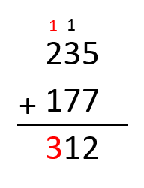
Common Errors
Using the wrong operation
Miscalculation
Regrouping
Notes:
[Review the errors and discuss how the students solved. What misconceptions?]

Slide 36
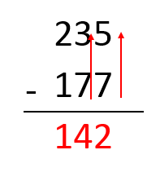
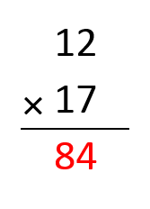
Common Errors
Always subtracts the smaller/least value number
Incomplete algorithm or steps
Notes:
[Review the errors and discuss how the students solved. What misconceptions?]

Slide 37
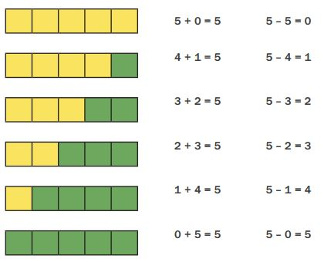
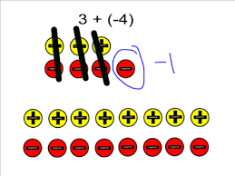
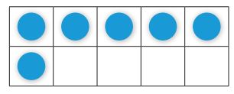
Instructional Progression: Evidence-Based Practices
Multiple representations
When a new strategy is introduced, it is best to start with the concrete representation(s)
Link concrete to part-part-whole mat, number lines, groups, integer chips/zero pairs
Move to a symbolic or pictorial representation(s)
Including number lines, ten-frames, pictures of the manipulatives
Abstract or equations alone
Notes:
The purpose of the representations is to show why the strategy works versus simply teaching a trick. For some students, seeing the concrete one time is enough, and they may move to pictorial quickly. For other students, concrete can be easier to work with or count, and they may need it much longer. Using the data and observations of how the students use each representation can aid in scaffolding back or providing less support via representations.

Slide 38
Scaffolding Within DBI
The scaffold, as it is known in building construction, has the following five characteristics:
It provides a support.
It functions as a tool.
It extends the range of the worker.
It enables a worker to accomplish a task not otherwise possible.
It is used to selectively aid the worker where needed (Greenfield, 1999, p. 118).
Types of instructional scaffolds
Teacher or peer
Content and task
Materials
Notes:
In the past, scaffolding was directed by the adult—the teacher or the tutor. Many more classrooms are becoming project or inquiry based, meaning that children are in charge of their learning, with the teacher acting as the facilitator. With this change, the way we think about scaffolds also changes. Now, the scaffold can be provided by the teacher, but also by a peer, in the actual skills, progression, or timing of the content, as well as changing the task. We will discuss ways to scaffold over the next few slides. It is important to think about the use of scaffolds paired with explicit instruction as a way to meet individual needs as part of the DBI process.

Slide 39
Teacher and Peer Scaffolds
Address prerequisite skills
Preview new skills
Types of questions or clarification questions
Including follow-up questions
Teach students to ask questions and explain thinking
Moves conversations away from only teacher–student to student–student
Reduce the “step size” from one idea or representation to the next
Teach the use of cognitive strategies
Notes:
It is important to remember that when we think of instructional scaffolds paired with explicit instruction, the teacher is providing support for the student to gain mastery of a specific skill. The purpose of gaining mastery with support is to build the student’s independence level; thus, when the support has faded, the student is able to perform the skills/tasks independently. Much like multiple representations, a student might need additional scaffolds one day and something different the next day. Or the student might be able to work without any additional scaffolds but will need the scaffolds when another step or a new skill is introduced. Again, this flexibility in the types of scaffolds used is similar to how multiple representations should be weaved and connected throughout skill building to mastery.

Slide 40
Content and Task Scaffolds
Build sequence of skills to introduce easier concepts first
Increase difficulty based on data
Use of high probability to develop worksheets
Sequence instruction so teacher models and then decreases role as lesson continues
Guide students to work with one another; reciprocal teaching
Notes:
[Read slide.]

Slide 41
Material Scaffolds
Types and sequences of manipulatives
Counters
Number lines
Ten-frames
Part-part-whole mats
Base 10 materials
Use of games and puzzles
Linking instruction to word walls
Use of technology
Notes:
[Read slide.]

Slide 42
Strategies: Addition and Subtraction
Connect to basic facts
Systematic practice
Create multidigit problems containing facts already mastered
Focus on the conceptual understanding rather than facts
Link operations through fact family
Use multiple representations to develop the understanding of how addition and subtraction are connected
Practice addition and subtraction together, as a means to check work, as well as to develop mastery
Notes:
[Read slide.] Linking operations from the beginning and through each fact strand is essential. This also supports students’ number sense and can lead to deeper conceptual understanding and application to facts, as well as, advanced computations and reasonableness of answers.

Slide 43
Strategies: Addition and Subtraction
Isolate the place-value columns.
28 2 tens 8 ones
+14 + 1 ten 4 ones
42 3 tens 12 ones = 4 tens, 2 ones
Connect to powers of 10 to help identify patterns within place value.
2 20 200
+3 +30 +300
5 50 500
Mix problems that require regrouping with those that do not.
Notes:
These are examples of how linking place value to facts within multidigit computations can lead to conceptual understanding and procedural fluency.

Slide 44
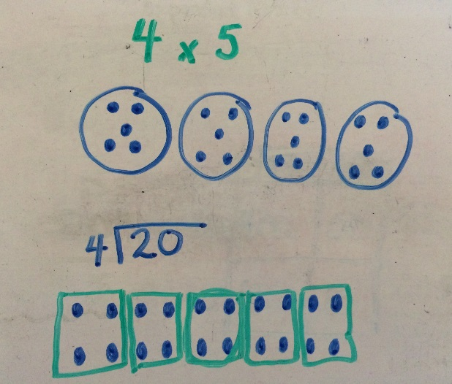
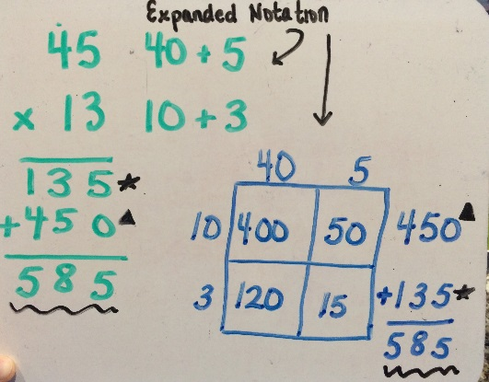
Strategies: Multiplication and Division
Connect to basic facts
Systematic practice
Create multidigit problems containing facts already mastered
Focus on the conceptual understanding rather than facts
Link operations through fact family
For division, think multiplication
Show how the operations are related
Show and explain the traditional algorithm
Notes:
[Read slide, emphasizing that it is important to teach conceptual understanding, rather than simply teaching the traditional algorithm alone.]

Slide 45
Case Examples: Error Analysis
Identifying Error Patterns to Help Individualize Instruction
Handout #6

Slide 46
Case Examples
Each slide contains a sample of a student progress monitoring measure.
Includes either facts or computation
Complete the table for each student.
Identify the type of error
Fact error/procedural error
Conceptual or misconception
What evidence do you have to justify the type of error?
What instructional adaptations are necessary?
Notes:
[Have participants complete each case study, or assign a different case study to groups of students and then have groups share their findings. Each handout contains the sample work. Participants will complete the type of error, the evidence for how they know whether it is a fact or strategy error, and possible instructional adaptions.]

Slide 47
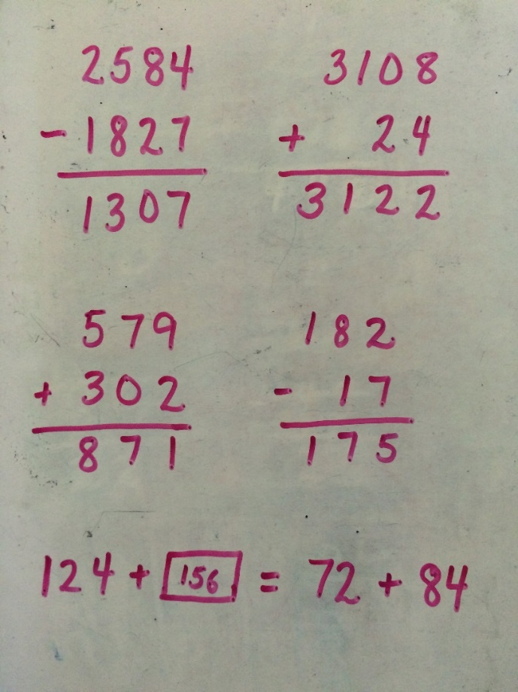
Case Example 1
Type of Error | What Evidence? | Instructional Adaptation(s)
Conceptual errors in regrouping Error in understanding equals sign and relationship between numbers | Did not regroup or subtract correctly in any | Use concrete manipulatives to show regrouping Have students write value to connect abstract with concrete Explicitly teach equals sign and how to balance
Notes:
[This will be completed by participants in small groups or individually and then reviewed together once it is complete. Empty tables are in the workbook.]

Slide 48
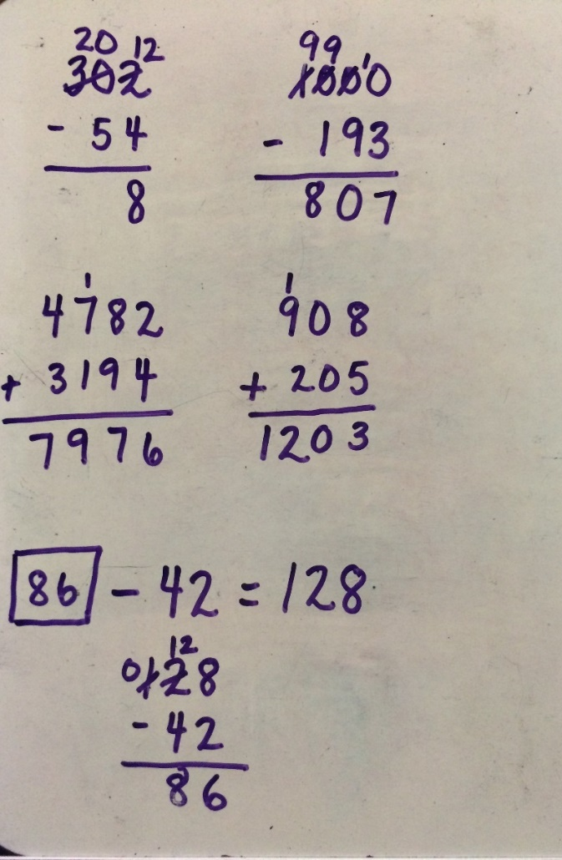
Case Example 2
Type of Error | What Evidence? | Instructional Adaptation(s)
Errors in regrouping with 0 Regrouping into wrong column Conceptual misconception of equals sign and relationship between addition and subtraction | Regrouped incorrectly in 1, 2 Regrouped the one 10 into the hundreds—4 Subtracted one part from another part | Have student build the problems to show regrouping Provide explicit instruction in how to regroup from 10s Explicitly teach the relationship between parts and wholes and how to find a missing value
Notes:
[This will be completed by participants in small groups or individually and then reviewed together once it is complete. Empty tables are in the workbook.]

Slide 49
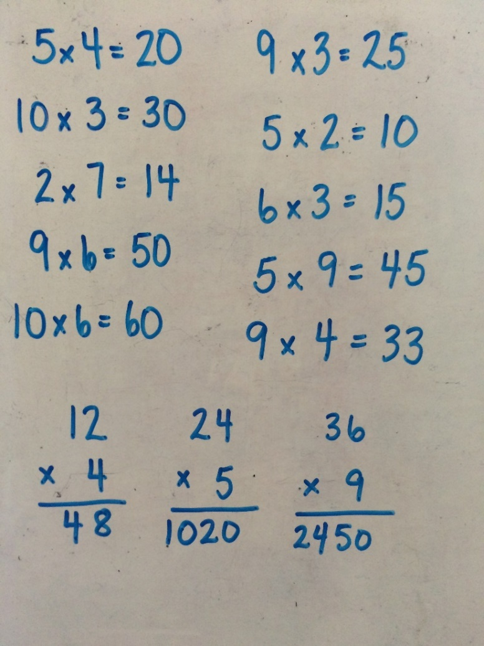
Case Example 3
Type of Error | What Evidence? | Instructional Adaptation(s)
Fact error (3s, 9 × 4; 9 × 6) Conceptual error in regrouping | All facts with 3s are wrong; 9 × 4 and 9 × 6 Did not regroup for last two problems | Review strategy for solving 3s and 9s, possibly 4s Have student verbalize the steps of the strategies Using arrays, explicitly teach how to regroup and then add the extra set(s)
Notes:
[This will be completed by participants in small groups or individually and then reviewed together once it is complete. Empty tables are in the workbook.]

Slide 50
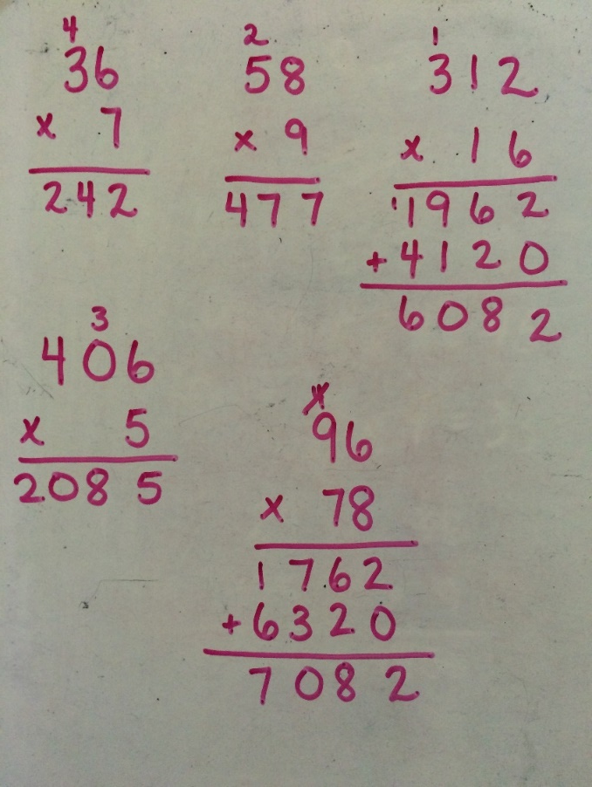
Case Example 4
Type of Error | What Evidence? | Instructional Adaptation(s)
Errors in adding (1) Errors in regrouping (2) Fact errors (6 × 8; 3 × 7) Conceptual/fact error treating 0 like ×1 Conceptual/fact error in 3 × 1 (3) | Fact errors (6 × 8, 7 × 3, 5 × 0, 3 × 1) | Retest for better understanding if there are fact errors or is a misconception Provide explicit instruction with place-value materials for double-digit multiplication
Notes:
[This will be completed by participants in small groups or individually and then reviewed together once it is complete. Empty tables are in the workbook.]

Slide 51
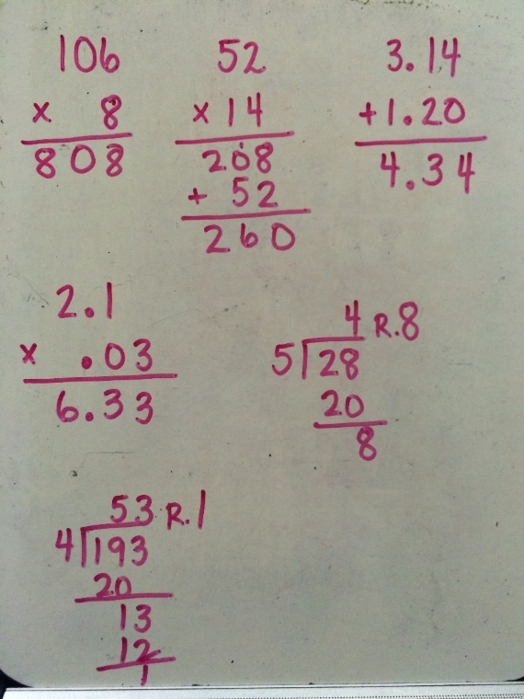
Case Example 5
Type of Error | What Evidence? | Instructional Adaptation(s)
Conceptual error in regrouping Conceptual error in place-value placement when multiplying double digits Conceptual error in multiplying decimals Conceptual/fact error in division | Is not writing the number to be regrouped and then not adding (1) Missing a 0 or not correctly writing the 2 tens and 5 hundreds (2) Long-division answers are either too high or too low | Provide explicit instruction with concrete materials in multiplying 2 digits × 1 digit Reintroduce long division and how to determine the amount of groups Use place-value materials to explicitly teach multiplication of decimals
Notes:
[This will be completed by participants in small groups or individually and then reviewed together once it is complete. Empty tables are in the workbook.]

Slide 52
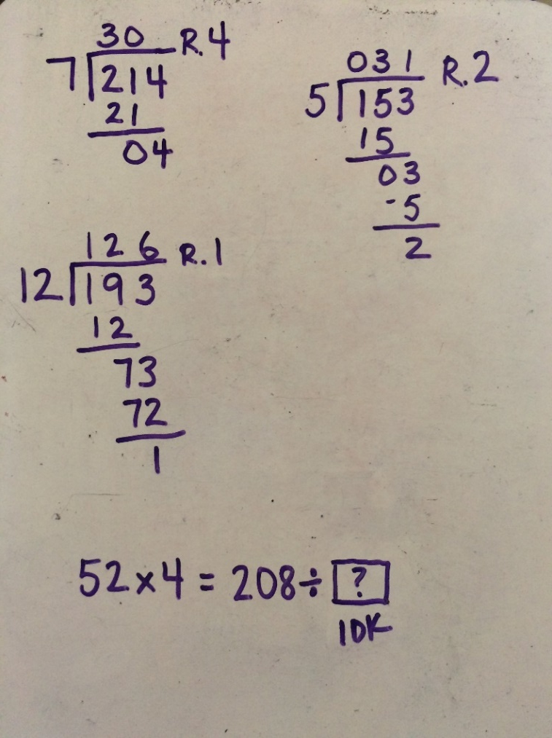
Case Example 6
Type of Error | What Evidence? | Instructional Adaptation(s)
Conceptual errors in understanding division Conceptually not understanding the relationship between multiplication and division | Placement of division answers with respect to place value (1, 3) No answer provided for 4 | Explicitly teach division with smaller numbers Use concrete manipulatives to show the relationship between multiplication and division
Notes:
[This will be completed by participants in small groups or individually and then reviewed together once it is complete. Empty tables are in the workbook.]

Slide 53
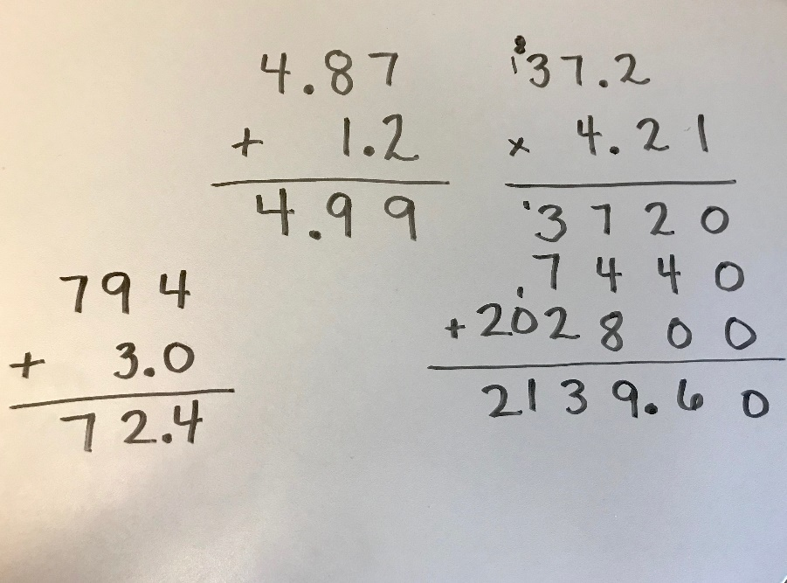
Case Example 7
Type of Error | What Evidence? | Instructional Adaptation(s)
Conceptual errors in understanding place value within decimals Procedural error in facts Procedural/ conceptual understanding of values of numbers | Not correctly lining up the decimal place in addition Lining up the decimal points in multiplication problem Incorrect multiplication and addition | Use base-10 materials to explain/show operations Draw arrays to show multiplication Review/ practice fact strategies
Notes:
[This will be completed by participants in small groups or individually and then reviewed together once it is complete. Empty tables are in the workbook.]

Slide 54
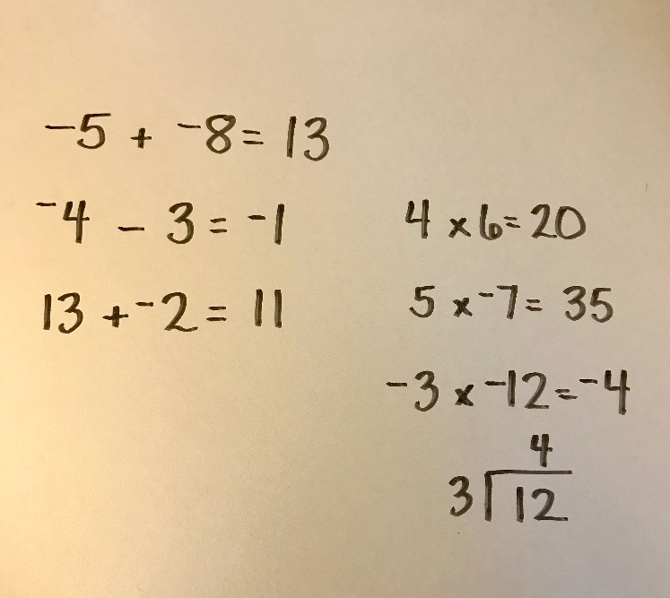
Case Example 8
Type of Error | What Evidence? | Instructional Adaptation(s)
Conceptual understanding of integers—positive and negative numbers Fact error Conceptual understanding of operation and generalizations within integer computations | Adding and subtracting but not associating the correct sign to the problem (not sure if the student understood 13 + −2 or if a lucky guess) Did not multiply correctly | Use integer chips and number line to understand adding and subtracting Identify patterns to create generalizations when multiplying and dividing integers Review facts
Notes:
[This will be completed by participants in small groups or individually and then reviewed together once it is complete. Empty tables are in the workbook.]

Slide 55
Case Examples: Class Analysis
Identifying Common Trends in Data to Drive Class Instruction and to Identify Students in Need of More Intensive Intervention
Handout #7
Notes:
[Have participants analyze each class. This can be done the same day or be given as prework or homework to be discussed at a later time. Participants should identify common strengths and weaknesses within the classes, as well as identify students needing more support in fact instruction and possible instructional adaptions.]

Slide 56
HELP!
The teacher has to design the intervention class to meet the needs of the 10 students.
Provide the following support by answering each question:
How should the teacher group the students?
Which fact strand should each student or group practice daily? How did you make this determination?
Thinking about the skills at grade level, where do you think the students will have the greatest challenge?
On which prerequisite skills should intervention groups focus?
What do you think will be the greatest challenge for this teacher?
Notes:
[Read slide.]

Slide 57
Class A: Grade 6
Math Fact Progress Monitoring (total correct)
100 facts per page; 1-minute timed test
Student Name | Addition | Subtraction | Multiplication | Division
Linda | 45 | 32 | 10 | 5
Saleh | 75 | 62 | 15 | 12
Isabel | 90 | 85 | 40 | 33
John | 82 | 54 | 15 | 8
Brad | 78 | 80 | 22 | 18
Krystal | 98 | 97 | 65 | 46
Riley | 90 | 32 | 71 | 22
Kevin | 59 | 58 | 26 | 21
Ethan | 93 | 89 | 70 | 61
Jenna | 21 | 18 | 3 | 2

Slide 58
Class A: Grade 6
AIMSWeb, BOY results on grade level
Student Name | M-Comp—Raw Score | M-Comp—Percentile
Linda | 5 | 11th
Saleh | 11 | 23rd
Isabel | 19 | 50th
John | 5 | 11th
Brad | 22 | 20th
Krystal | 30 | 73rd
Riley | 19 | 50th
Kevin | 12 | 25th
Ethan | 29 | 70th
Jenna | 0 | 0

Slide 59
Class B: Grade 7
Math Fact Progress Monitoring (total correct)
100 facts per page; 1-minute timed test
Student Name | Addition | Subtraction | Multiplication | Division
Elaine | 13 | 8 | 2 | 1
Finn | 92 | 89 | 40 | 32
Lindsey | 87 | 75 | 48 | 36
Thomas | 40 | 41 | 28 | 17
Lauren | 74 | 70 | 55 | 48
Robin | 68 | 62 | 39 | 23
Jackson | 100 | 98 | 71 | 54
Payton | 43 | 52 | 29 | 12
Misty | 89 | 76 | 50 | 48
Ben | 92 | 87 | 51 | 50

Slide 60
Class B: Grade 7
AIMSWeb, BOY results on grade level
Student Name | M-Comp—Raw Score | M-Comp—Percentile
Elaine | 1 | 1st
Finn | 12 | 27th
Lindsey | 12 | 27th
Thomas | 8 | 20th
Lauren | 10 | 25th
Robin | 8 | 3rd
Jackson | 23 | 52nd
Payton | 4 | 8th
Misty | 7 | 18th
Ben | 5 | 10th

Slide 61
Conclusion
Handout #8

Slide 62
In Summary
Explicit instruction of basic math facts is vital! For students who struggle, teachers must be systematic in how they deliver fact instruction.
Students need mastery of facts, starting with addition and subtraction, to be successful in multidigit computations, thus freeing their working memory.
For older students who have received instruction in addition and subtraction but still lack mastery, they could be transitioned to calculators with explicit instruction in multiplication and division, reviewing addition and subtraction regularly.
Teachers should use multiple representations to show how to solve facts and build conceptual understanding that leads to procedural fluency.
Notes:
[Read slide.]

Slide 63
Questions and Discussion

Slide 64
References
Geary, D. (1993). Mathematical disabilities: Cognitive, neuropsychological, and genetic components. Psychological Bulletin, 114(2), 345–362.
Geary, D. (2005). Role of cognitive theory in the study of learning disabilities in mathematics. Journal of Learning Disabilities, 38(4), 305–307.
Gray, E., Pinto, M., Pitta, D., & Tall, D. (1999). Knowledge construction and diverging thinking in elementary and advanced mathematics. Educational Studies in Mathematics, 38, 111–133.
Greenfield, P. M. (1999). Historical change and cognitive change: A two-decade follow-up study in Zinacantán, a Maya community in Chiapas, Mexico. Mind, Culture, and Activity, 6, 92–98.
Hecht, S., Close, L., & Santisi, M. (2003). Sources of individual differences in fraction skills. Journal of Experimental Child Psychology, 86, 277–302. doi:10.1016/j.jeep.2003.08.003
Impecoven-Lind, L. S., & Foegen, A. (2010). Teaching algebra to students with learning disabilities. Intervention in School and Clinic, 46(1), 31–37. doi:10.1177/1053451210369520

Slide 65
References (continued)
Jayanthi, M., Gersten, R., & Baker, S. (2008). Mathematics instruction for students with learning disabilities or difficulty learning mathematics: A guide for teachers. Portsmouth, NH: RMC Research Corporation, Center on Instruction.
National Council of Teachers of Mathematics. (2002). Standards and expectations. Retrieved from http://www.nctm.org/standards/content.aspx?id=4294967312
National Council of Teachers of Mathematics. (2014). Principles to actions. Ensuring mathematical success for all. Reston, VA: The National Council of Teachers of Mathematics, Inc.
National Governors Association Center for Best Practices & Council of Chief State School Officers. (2010). Common Core State Standards for Mathematics. Washington, DC: Authors.
National Mathematics Advisory Panel. (2008, March). Foundations for success: The final report of the National Mathematics Advisory Panel. Washington, DC: U.S. Department of Education. Retrieved from http://www.ed.gov/about/bdscomm/list/mathpanel/report/final-report.pdf

Slide 66
References (continued)
Raghubar, K., Barnes, M., & Hecht, S. (2009). Working memory and mathematics: A review of developmental, individual difference, and cognitive approaches. Learning and Individual Differences, 20, 110–122. doi:10.1016/j.lindif.2009.10.005
Swanson, H. L., & Jerman, O. (2006). Math disabilities: A selective meta-analysis of the literature. Review of Educational Research, 76(2), 249–274. doi:10.3102/00346543076002249
Swanson, H. L., Jerman, O., & Zheng, X. (2008). Growth in working memory and mathematical problem solving in children at risk and not at risk for serious math difficulties. Journal of Educational Psychology, 100(2), 343–379. doi:10.1037/0022-0663.100.2.343

Slide 67
Disclaimer
This module was produced under a grant from the Investing in Innovation Fund (i3), U.S. Department of Education, Award No. U411C140029. The views expressed herein do not necessarily represent the positions or polices of the U.S. Department of Education. No official endorsement by the U.S. Department of Education of any product, commodity, service, or enterprise mentioned in this website is intended or should be inferred.

Slide 68
AIR Info
1000 Thomas Jefferson Street NW
Washington, DC 20007-3835
General Information: 202-403-5000
www.air.org

